Slide 1


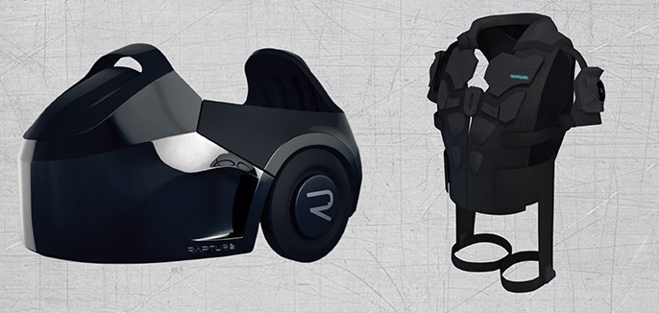
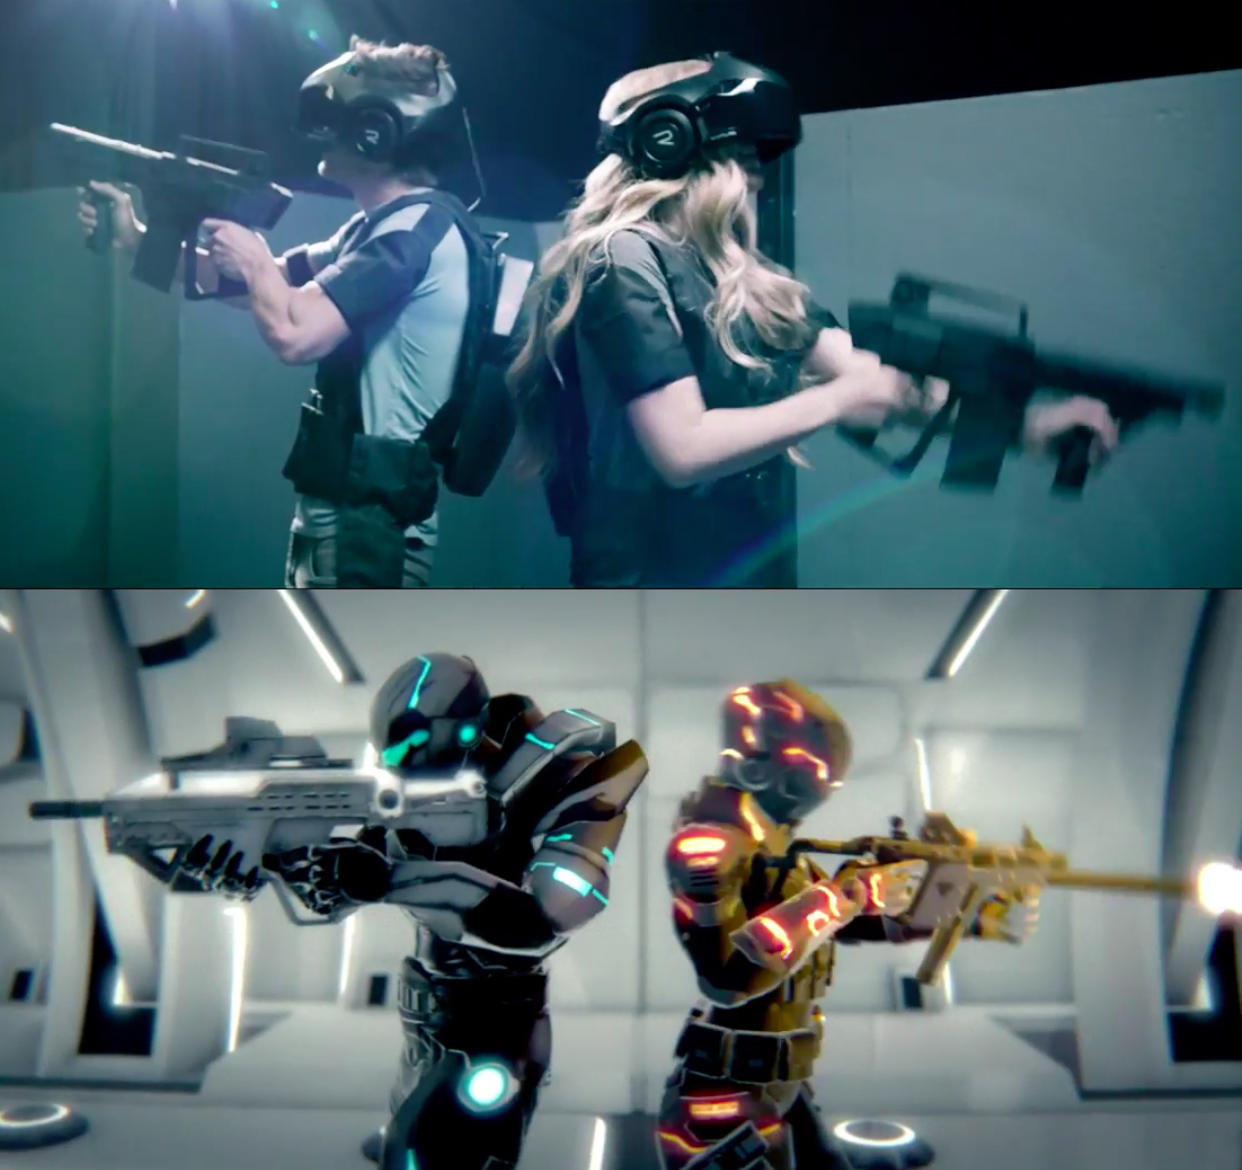

Slide 2

Vision of Infinite Dimensions
Whole body, fully immersive VR experience

Slide 3
Why is it a good use of VR? Why is it unique? What’s cool about it?
The void built in LAN environment avoiding latency issues and provide physical feedback.
It is unique cause it has hyperreality experience hinge on a VR environment.
The void can use a combination of virtual reality hardware with motion tracking.
The VOID is starting to realize the vision of exploring infinite virtual worlds at 1:1 scale

Slide 4
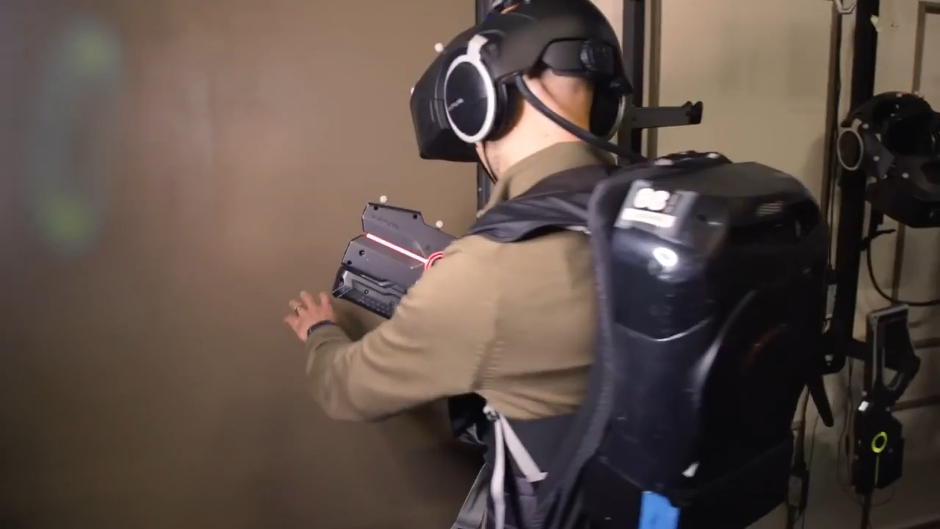

Slide 5

History of The Void
The Void was co-founded by Ken Bretschneider, Curtis Hickman and James M.Jensen. Bretschneider focused on developing the void after he decided to stop Evermore project.

Slide 6
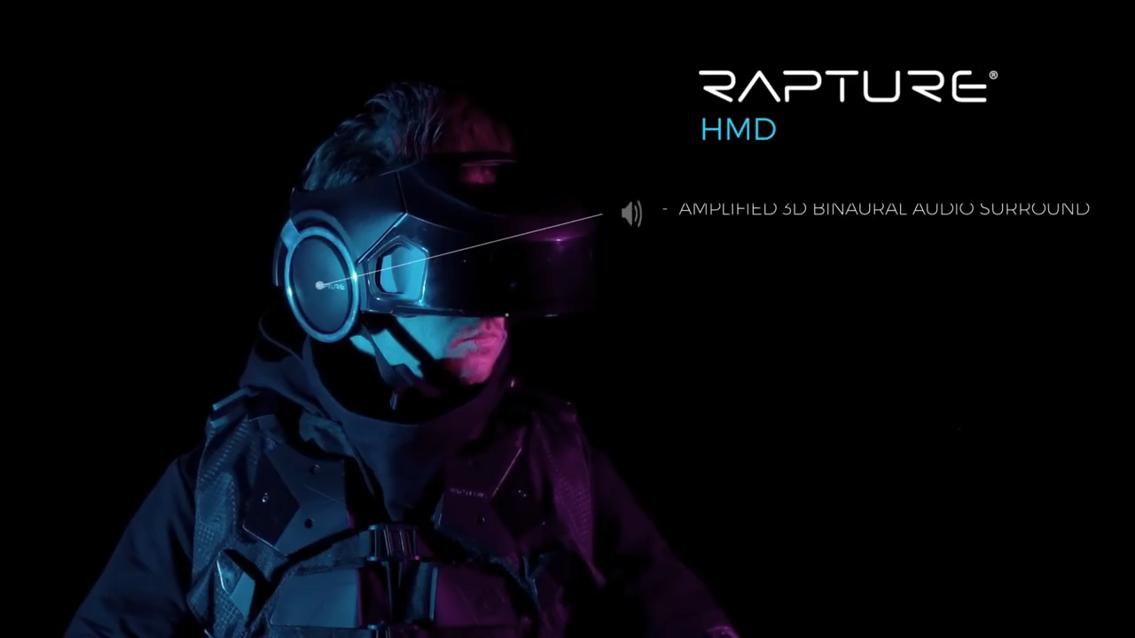
Technology

Slide 7
The void simulated the interior of a spaceship utilizing an Oculus Rift developer kit which used for position tracking. The vest system utilized an Oculus Rift Devlopment Kit2, Beats by Dr. Dre headphones and a Leap Motion unit for hand tracking.
How does it work?

Slide 8
Where is it used? What are best suited applications?
The void is designed to allow the users to freely walk through and explore a virtual world.
For playing, education-oriented experience like police tranning and nature exploration.

Slide 9
Critique on strengths and weaknesses/issues such as design flaws or technical flaws. Is there still more to do?
Now there are just two experience -an exploration adventure set in a jungle temple, and an action romp in the Ghostbust universe.

Slide 10
0: Normal (no motion sickness at all)
5: Average (lead to dizziness) -> can not use it for more than a few minutes
10: Max (can be dangerous)
0

Slide 11
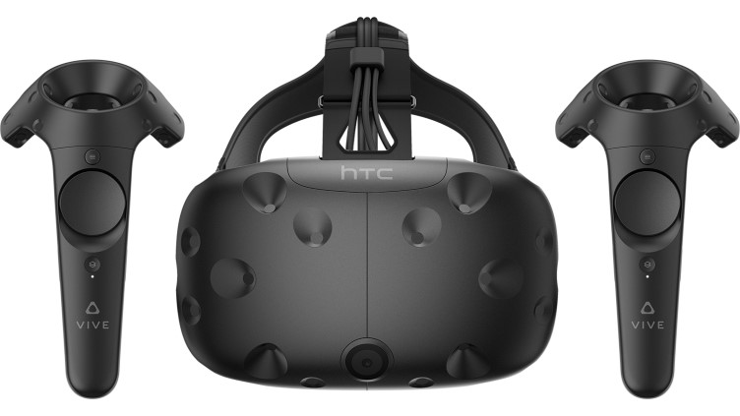
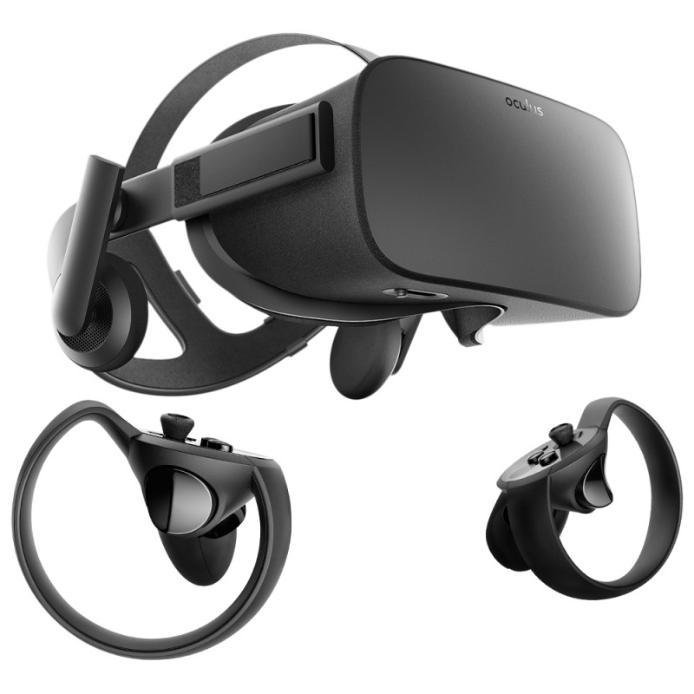
What are the similar/related applications?
HTC VIVE
Oculus Rift

Slide 12
Reference
https://www.technologyreview.com/s/544096/inside-the-first-vr-theme-park/
https://www.wired.com/2017/02/the-void-vr-game/
https://www.digitaltrends.com/computing/how-the-void-plans-to-put-reality-back-in-virtual-reality/

